Slide 1
Policy Evaluation: Benefit-Cost Analysis (BCA)
Spring 2025
API 102B, Harvard Kennedy School
Prof. Josh Abel

Slide 2
Policy Evaluation
Policy has varied impacts:
  Size of pie (efficiency)
  Distribution of pie (equity)
Time and uncertainty can also be important
BCA provides a framework to aggregate these complexities into a single recommendation:
  “Policy A is better than the status quo.”
  “Policy A is worse than Policy B.”
  “Policy A is optimal.”
    (But of course, it’s never quite so simple!)

Slide 3
4 Steps
1. Identify costs and benefits
2. Quantify costs and benefits
3. Aggregate costs and benefits
4. Consider analysis’s “blind spots”

Slide 4
Towards a Policy Evaluation Criterion

Slide 5
Pareto Criterion
If someone prefers policy A to policy B and no one prefers policy B to policy A, then implement policy A.
Any policy that meets the Pareto criterion is a no-brainer.
Problem:

Slide 6
Pareto Criterion
If someone prefers policy A to policy B and no one prefers policy B to policy A, then implement policy A.
Any policy that meets the Pareto criterion is a no-brainer.
Problem: it’s an incomplete measure
If some prefer A and some prefer B, we’re stuck!
But as policymakers, you need to make decisions, one way or another
Need something sharper

Slide 7
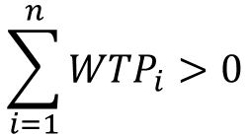

Kaldor-Hicks Criterion
$${WTP}_{i}=B_{i}−C_{i}$$
B_{i} is the dollar value of consumer i’s benefit from the policy
C_{i} is the dollar value of the cost imposed on consumer i by the policy
Kaldor-Hicks: policy should be implemented if:
$$\sum_{i=1}^{n}{{WTP}_{i}}>0$$
Rationale: policy generates surplus so we could implement transfers to make everyone better off (even if we do not)

Slide 8
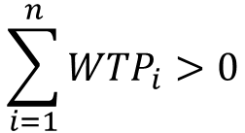
Kaldor-Hicks, Critiqued
$$\sum_{i=1}^{n}{{WTP}_{i}}>0$$
This criterion just says to maximize efficiency
Theory justifies this only if you are a utilitarian (“$1 = $1, no matter who has it”)
If you do not make the transfers, some people may be hurt – the policy could be bad
If you do decide to make the transfers, this criterion ignores that transfers cause DWL
You may not actually be able to make everyone better off!

Slide 9
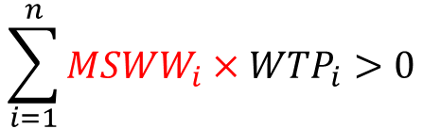
Kaldor-Hicks, Corrected
$$\sum_{i=1}^{n}{{{MSWW}_{i}×WTP}_{i}}>0$$
This criterion says to maximize social welfare
Some people count more (on the margin) – typically those with lower income
What should the MSWW weights be?
Hendren (2020) suggests using the weights we derived from the tax code!
If you do decide to make the transfers
You can make everyone better off via redistribution, even accounting for DWL

Slide 10
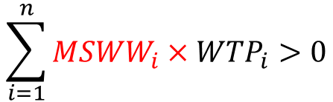
Linking Hendren with Pareto
$$\sum_{i=1}^{n}{{{MSWW}_{i}×WTP}_{i}}>0$$
If a policy helps the rich but hurts the poor, it better really help the rich, so that we can then tax them and make everyone better off – a Pareto improvement! – accounting for DWL of taxation
    Because the rich have low MSWW weights, the efficiency gain must be substantial
If a policy helps the poor but hurts the rich, we could get a Pareto improvement by lessening our redistributive tax.
Because the poor have high MSWW weights, the efficiency gains do not need to be large (or even positive!)
You can still make everyone better off with an offsetting reduction in redistribution, thereby growing the pie and helping the rich

Slide 11
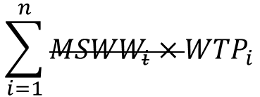
BCA in Practice
$$\sum_{i=1}^{n}{{{MSWW}_{i}×WTP}_{i}}$$
BCA frequently ignores distribution
i.e. focuses on efficiency/Kaldor-Hicks criterion

Slide 12

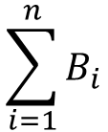
BCA in Practice
$$\sum_{i=1}^{n}{B_{i}}$$
$$− Cost$$
BCA frequently ignores distribution
If cost is explicitly born by government, can simplify further
i.e. focuses on efficiency/Kaldor-Hicks criterion
(This is wrong if you use the welfare weights – you would need to specify who would bear the tax burden of the project, which is potentially quite challenging.)

Slide 13

BCA in Practice
$$Benefit− Cost$$
BCA frequently ignores distribution
If cost is explicitly born by government, can simplify further
  In fact, often ignore any kind of heterogeneity
  These simplifications are okay – doing this stuff can be hard enough without worrying about heterogeneity and distribution – but you should be aware of blind spots
i.e. focuses on efficiency/Kaldor-Hicks criterion
(This is wrong if you use the welfare weights – you would need to specify who would bear the tax burden of the project, which is potentially quite challenging.)

Slide 14
Identifying Benefits and Costs

Slide 15

What are this project’s “costs?”
Materials: total outlays = $800k
would not have been created
Contractors: total payments = $200k
would have worked for a different client
Government engineer: salary = $100k
would have been overseeing a different project

Slide 16
Some Takeaways
Opportunity costs vs accounting costs
Government cost vs social costs
Compare to “but-for”/“counterfactual” world without the project (ignore sunk costs)
Same if goods/services are provided “at cost”
Differ if there is a profit margin or good/service is underemployed
Assuming the former simplifies things, so it’s the typical approach
Why might a project “feel lower-cost” during a recession?

Slide 17
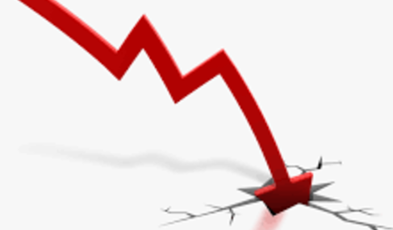

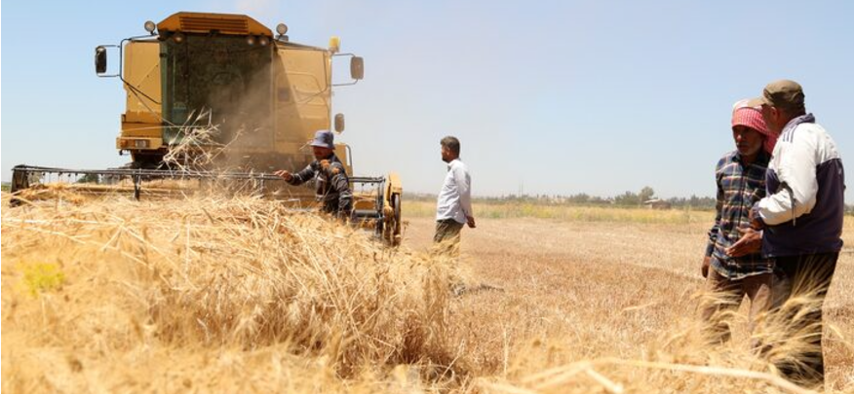
Results
What are this policy’s “benefits?”
Land was owned by absentee owners and lay fallow
Policy: expropriate land and give to small farmers, who grow crops
Local GDP increases by 10%
Land prices fall by 30%
Old owners poorer, new owners richer

Slide 18
Some Takeaways
Transfers are not relevant for efficiency
GDP and benefits/efficiency are not the same
Prices can at times reveal value!
Only matter if you put different weights on different people (which you probably do!)
GDP ignores effort costs (forced labor may boost GDP but is inefficient [and immoral…])
But this assumes private owners value the same things as the policymaker
Suppose you see stock prices jump up. How would your interpretation differ if it’s due to:
A new trade policy that lowers transactions costs
A reduction in the corporate tax rate

Slide 19
Quantifying Benefits and Costs

Slide 20
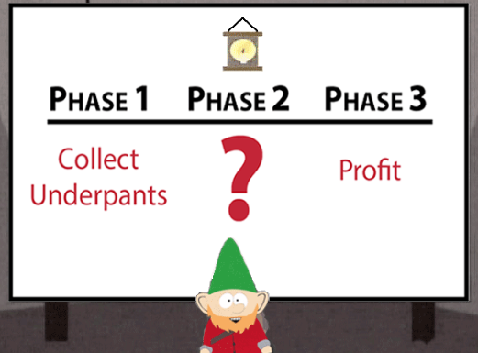

Slide 21
Value of a Statistical Life
Some policies save (or cost) lives
Need to place a value on those lives (VSL = “Value of a Statistical Life”)
Feels morally icky
But sort of necessary for informed policy

Slide 22
Calculating VSL
Willing to pay X to reduce risk of death by δ
If X = $1,000 and δ = 1/10,000…
  What do you think of that?
VSL = X/δ
…you value “one 10,000th of your life” at $1,000…
…so you value your whole life at 10,000*$1,000 = $10,000,000

Slide 23
Calculating VSL
Willing to pay X to reduce risk of death by δ
If X = $1,000 and δ = 1/10,000…
  What do you think of that?
VSL = X/δ
…you value “one 10,000th of your life” at $1,000…
…so you value your whole life at 10,000*$1,000 = $10,000,000
WTP brings up familiar equity/justice issues
Probably over-extrapolating a marginal change
But most policies don’t add/subtract whole lives: they make marginal changes to these probabilities!

Slide 24
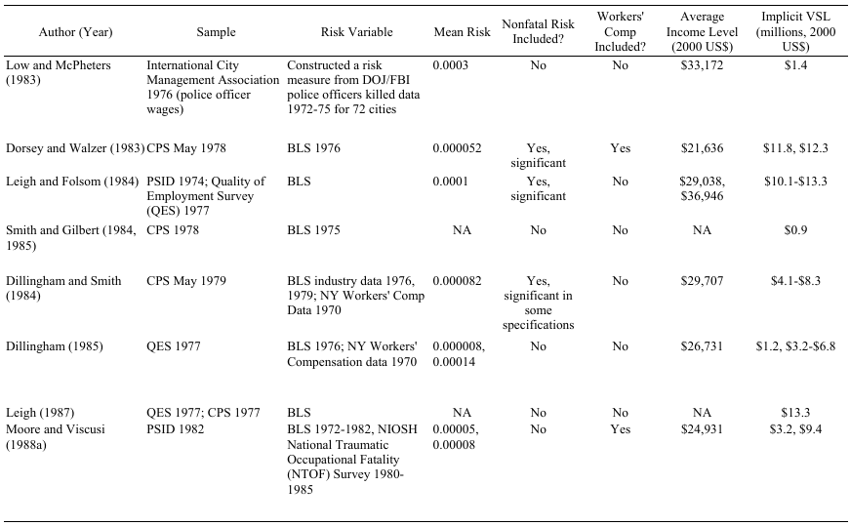
VSL and Compensating Differentials

Slide 25
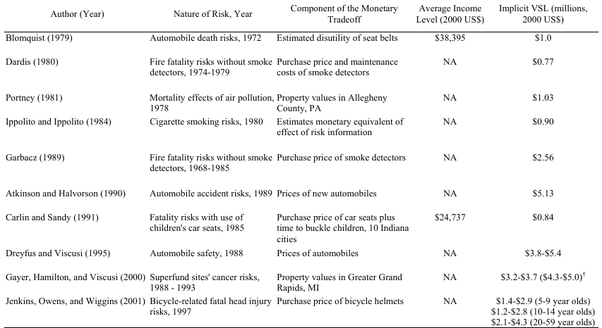
VSL and Compensating Differentials

Slide 26
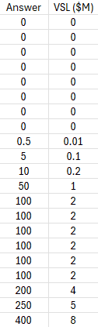
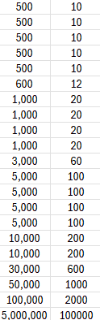
Your answers

Slide 27
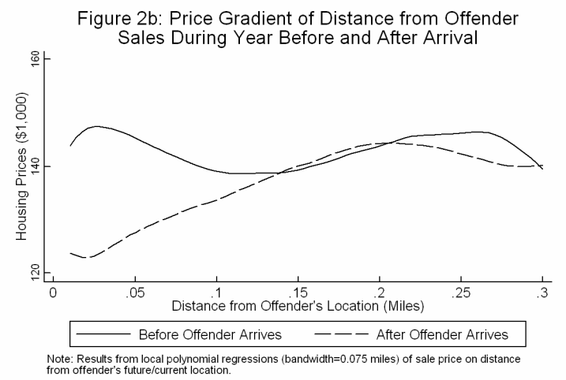
Another Example of “Price Hedonics”
Linden and Rockoff (2008)

Slide 28
Some Takeaways
Those examples were classic economics
  Revealed preference
    Behavior reveals values, assuming rationality
      i.e. price/wage informs about WTP
In many cases, you’ll need lots of input from people with other expertise
  Engineers, climate scientists, doctors, geologists, etc…
  E.g. how expensive will a land reclamation project be? How will it affect environment? Etc.

Slide 29
“Can’t we just ask people how much they value things?”

Slide 34
Time and Uncertainty

Slide 35
Time Value of Money
Suppose you have a savings account with a 1% annual interest rate
Someone offers you two choices:
  You can have $1 today, or
  You can have $1 in a year
  Which do you choose?

Slide 36
Time Value of Money
Suppose you have a savings account with a 1% annual interest rate
Someone offers you two choices:
  You can have $1 today, or
  You can have $1 in a year
  Which do you choose?
If you accept the $1 today, you can save it and it becomes $1.01 in a year
  Choose $1 today!
Money today is worth more than money in the future

Slide 37
Discounting Example
Savings account has a 1% annual interest rate. What is $1 in a year worth today?
How much money would you need today in order to end up with $1 in a year?

Slide 38
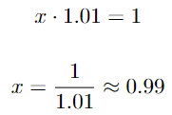
Discounting Example
Savings account has a 1% annual interest rate. What is $1 in a year worth today?
How much money would you need today in order to end up with $1 in a year?

Slide 39
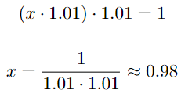
Discounting Example
Savings account has a 1% annual interest rate. What is $1 in a year worth today?
How much money would you need today in order to end up with $1 in a year?
How much is $1 in 2 years worth today?

Slide 40


Present Discounted Value
Consider an asset offering payments of
The present discounted value (PDV) is the sum of the discounted series of payments, given by:

Slide 41
Discount Rates in Practice
OMB says to use both 3% and 7%
  “Robustness check”
3% roughly corresponds to average return on Treasury debt (risk-free)
7% roughly corresponds to average return on private capital (risky)

Slide 42
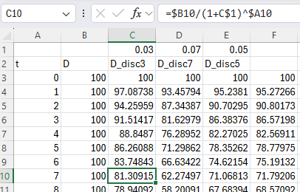
Discounting Example

Slide 43
Discounting Example

Slide 44
Discounting Example

Slide 45
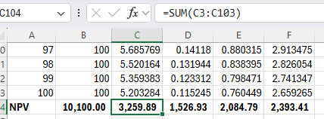
Discounting Example

Slide 46
Discount Rates in Practice
OMB says to use both 3% and 7%
  “Robustness check”
3% roughly corresponds to average return on Treasury debt (risk-free)
7% roughly corresponds to average return on private capital (risky)
Arrow et al (2013) point out that if there is uncertainty about the appropriate discount rate, you should discount at a rate lower than the average discount rate…

Slide 47
Discounting Example

Slide 48
Speaking of risk…
Suppose farm drainage project depends on like whether there is a drought:
  90% probability: no drought, PDV = $1,000,000
  10% probability: drought, PDV = $0
    How should this be valued?

Slide 49
Speaking of risk…
Suppose farm drainage project depends on like whether there is a drought:
  90% probability: no drought, PDV = $1,000,000
  10% probability: drought, PDV = $0
    How should this be valued?
“Expected” PDV = 0.9*$1,000,000 + 0.1*$0 = $900,000
This is how it’s done. Simple, right?
What’s wrong with this, from an economic perspective?
  Do you think we should value the project more or less than $900k?

Slide 50
Speaking of risk…
Suppose farm irrigation project depends on like whether there is a drought:
  90% probability: no drought, PDV = $0
  10% probability: drought, PDV = $1,000,000
    How should this be valued?
“Expected” PDV = 0.9*$0 + 0.1* $1,000,000 = $100,000
This is how it’s done. Simple, right?
What’s wrong with this, from an economic perspective?
  Do you think we should value the project more or less than $100k?
  How about now?
Challenge question: how does this relate to why we usually discount uncertain outcomes more than certain outcomes? When should we discount them less?

Slide 51
Assumptions that Go into a Typical BCA
$1 = $1 no matter who has it (MSWW = 1 for all people)
$1 = $1 no matter the state of the world (no risk aversion)
Discounting occurs at 3% and/or 7%
Market prices reflect social costs
Your economic/climate/etc model is correct

Slide 52
Assumptions that Go into a Typical BCA
$1 = $1 no matter who has it (MSWW = 1 for all people)
$1 = $1 no matter the state of the world (no risk aversion)
Discounting occurs at 3% and/or 7%
Market prices reflect social costs
Your economic/climate/etc model is correct
“Favor” projects that benefit the poor
“Favor” projects that pay out in bad states of the world
“Favor” projects with upfront costs and delayed benefits
“Favor” projects that use under-utilized resources

Slide 53
Assumptions that Go into a Typical BCA
$1 = $1 no matter who has it (MSWW = 1 for all people)
$1 = $1 no matter the state of the world (no risk aversion)
Discounting occurs at 3% and/or 7%
Market prices reflect social costs
Your economic/climate/etc model is correct
“Favor” projects that benefit the poor
“Favor” projects that pay out in bad states of the world
“Favor” projects with upfront costs and delayed benefits
“Favor” projects that use under-utilized resources

Slide 54
Examples

Slide 55
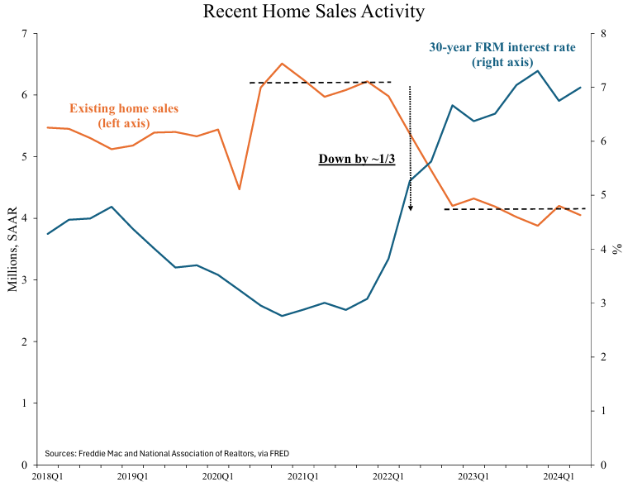
Mortgage Lock-In

Slide 56
The Welfare Economics of Mortgage Lock-In
Interest on a new mortgage: 4%
Lenders
A
B
1
2
Mortgage interest: 4% 4%

Slide 57
The Welfare Economics of Mortgage Lock-In
Interest on a new mortgage: 4%
Trade occurs!
Efficient!
Lenders
Better housing matches (PDV) for A and B
Moving costs paid by A and B
B
A
1
2
Benefits Costs
Mortgage interest: 4% 4%
(If trade occurs.)
4% 4%

Slide 58
The Welfare Economics of Mortgage Lock-In
Interest on a new mortgage: 8%
Lenders
Higher mortgage payments
To lenders
Bigger pmts by A and B
Better housing matches (PDV) for A and B
Moving costs paid by A and B
B
A
1
2
Benefits Costs
Mortgage interest: 4% 4%
(If trade occurs.)
8% 8%

Slide 59
The Welfare Economics of Mortgage Lock-In
Interest on a new mortgage: 8%
Trade does not occur.
Inefficient!
Lenders
To lenders
Bigger pmts by A and B
Better housing matches (PDV) for A and B
Moving costs paid by A and B
A
B
1
2
Benefits Costs
Mortgage interest: 4% 4%
(If trade occurs.)

Slide 60
The Welfare Economics of Mortgage Lock-In
Interest on a new mortgage: 8%
Lenders
To lenders
Higher mortgage payments
Credit from gov’t
To A and B
Bigger pmts by A and B
Better housing matches (PDV) for A and B
Moving costs paid by A and B
B
A
1
2
Benefits Costs
Mortgage interest: 4% 4%
(If trade occurs.)
8% 8%
Tax credit

Slide 61
The Welfare Economics of Mortgage Lock-In
Trade occurs!
Efficient!
Good, right?!
Interest on a new mortgage: 8%
Lenders
To lenders
Higher mortgage payments
Credit from gov’t
To A and B
Bigger pmts by A and B
Better housing matches (PDV) for A and B
Moving costs paid by A and B
B
A
1
2
Benefits Costs
Mortgage interest: 4% 4%
(If trade occurs.)
8% 8%
Tax credit

Slide 62
4 Steps
1. Identify costs and benefits
2. Quantify costs and benefits
3. Aggregate costs and benefits
4. Consider analysis’s “blind spots”

Slide 63
Abel (2024)’s Analysis of Tax Credit for Movers
Benefits: improved match quality
Costs: more moving costs
(Transfer is ignored…)
Match quality: (see paper)
Moving costs: ~9% of home value
Expected PDV of +0.02% housing market value
Roughly $40 of gov’t credit for every $1 of net benefit
(…transfer is a big deal!)

Slide 64
Abel (2024)’s Analysis of Tax Credit for Movers
Benefits: improved match quality
Costs: more moving costs
(Transfer is ignored…)
Increases efficiency, but basically just a transfer to homeowners – not a good policy!
Strict BCA favors the tax credit
But fuller analysis (likely) does not
  Strict BCA ignores transfers (i.e. from taxpayers to homeowners), but we should not!
Match quality: (see paper)
Moving costs: ~9% of home value
Expected PDV of +0.02% housing market value
Roughly $40 of gov’t credit for every $1 of net benefit
(…transfer is a big deal!)

Slide 65
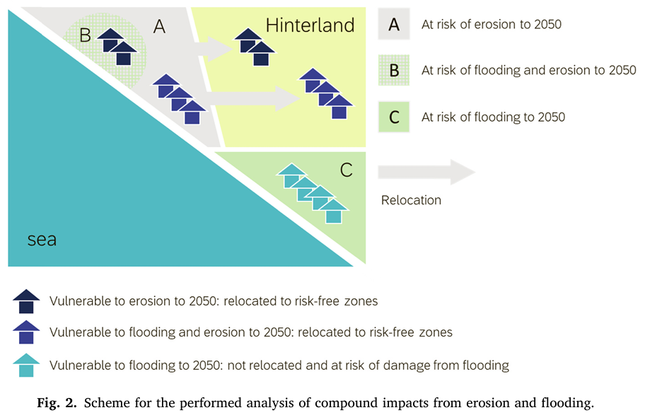
Das Neves, Bolle, and De Nocker (2023)

Slide 66
Policies Considered
Maintain current coastline (most aggressive; highest benefits and costs)
Retreat from region subject to erosion and flooding
Retreat from region subject to erosion; flood-proof region subject to flooding (least aggressive)
All are compared to a baseline of taking no action.
Benefits: lives, land, and economic prosperity preserved
Costs: implementation

Slide 67
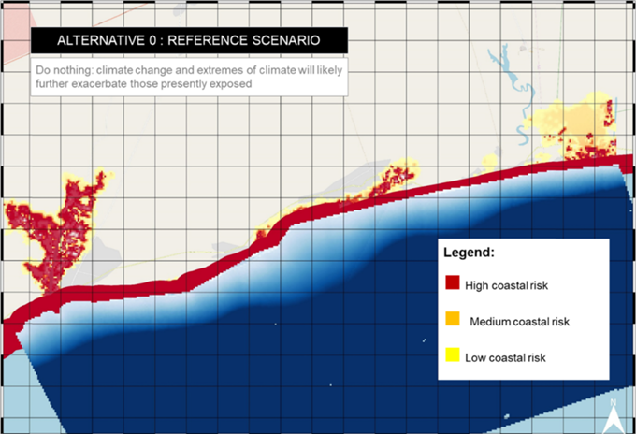
Policies Visualized

Slide 68
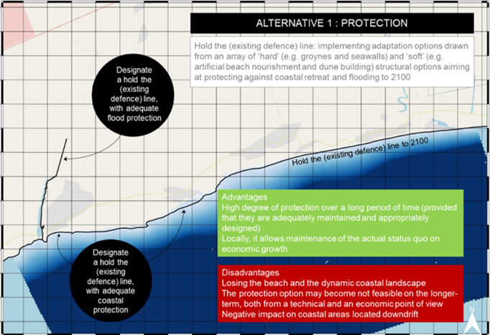
Policies Visualized

Slide 69
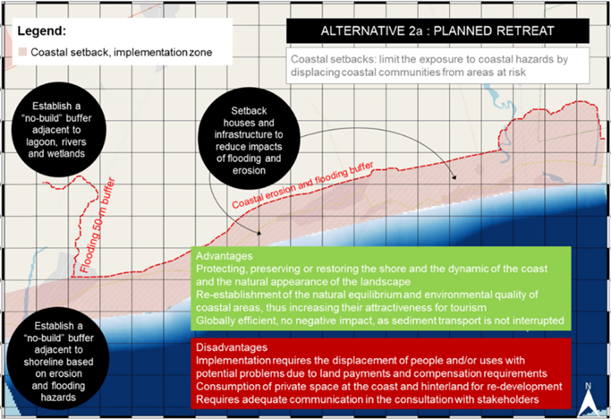
Policies Visualized

Slide 70
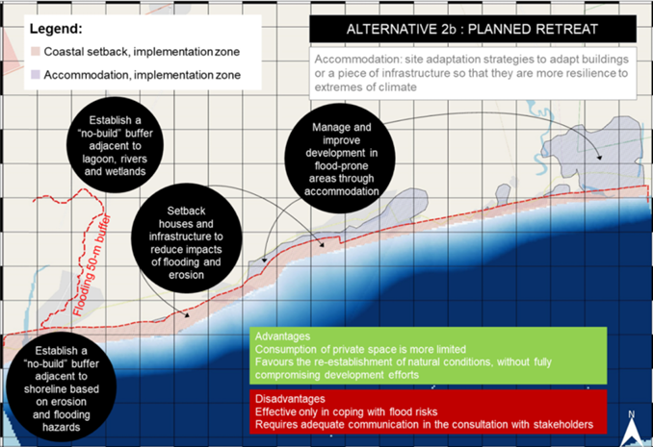
Policies Visualized

Slide 71
Sketch of Quantification Approach
Benefits: lives, land, and economic prosperity preserved
Costs: implementation
Lives: flooding costs 0.07 lives/year per 1,000 people exposed; valued by VSL, scaled by GDP/capita
Economic prosperity: national GDP/capita, scaled by number of people
Buildings etc. valued at their replacement costs
Costs from previous efforts at maintaining coastline and resettlement

Slide 72
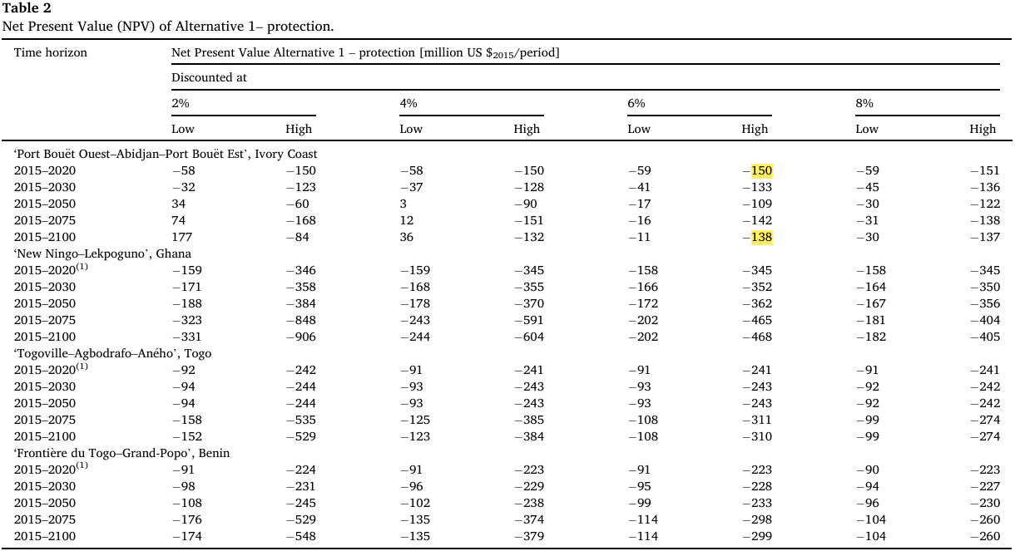
Sketch of Quantification Approach
Benefits: lives, land, and economic prosperity preserved
Costs: implementation
Lives: flooding costs 0.07 lives/year per 1,000 people exposed; valued by VSL, scaled by GDP/capita
Economic prosperity: national GDP/capita, scaled by number of people
Buildings etc. valued at their replacement costs
Costs from previous efforts at maintaining coastline and resettlement

Slide 73
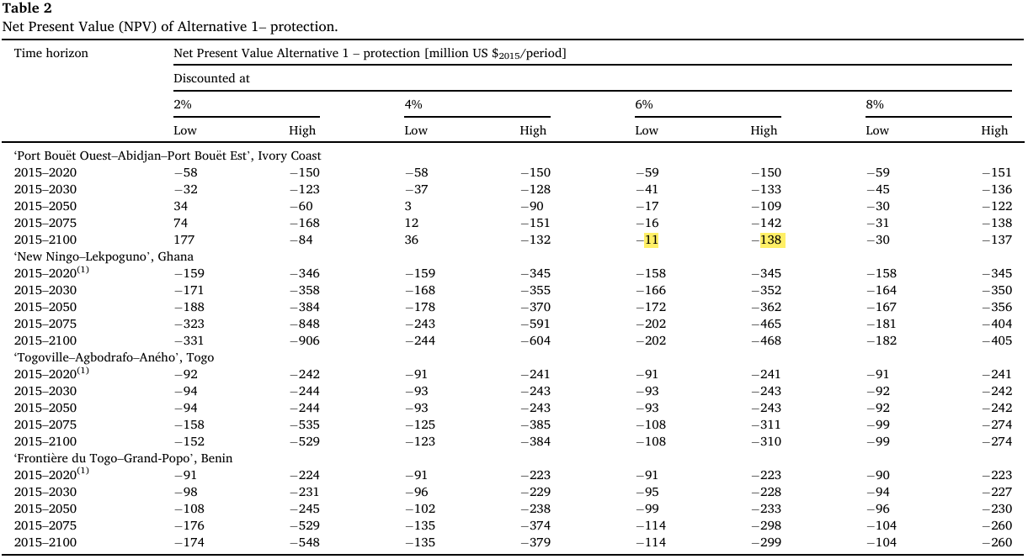
Sketch of Quantification Approach
Benefits: lives, land, and economic prosperity preserved
Costs: implementation
Lives: flooding costs 0.07 lives/year per 1,000 people exposed; valued by VSL, scaled by GDP/capita
Economic prosperity: national GDP/capita, scaled by number of people
Buildings etc. valued at their replacement costs
Costs from previous efforts at maintaining coastline and resettlement

Slide 74
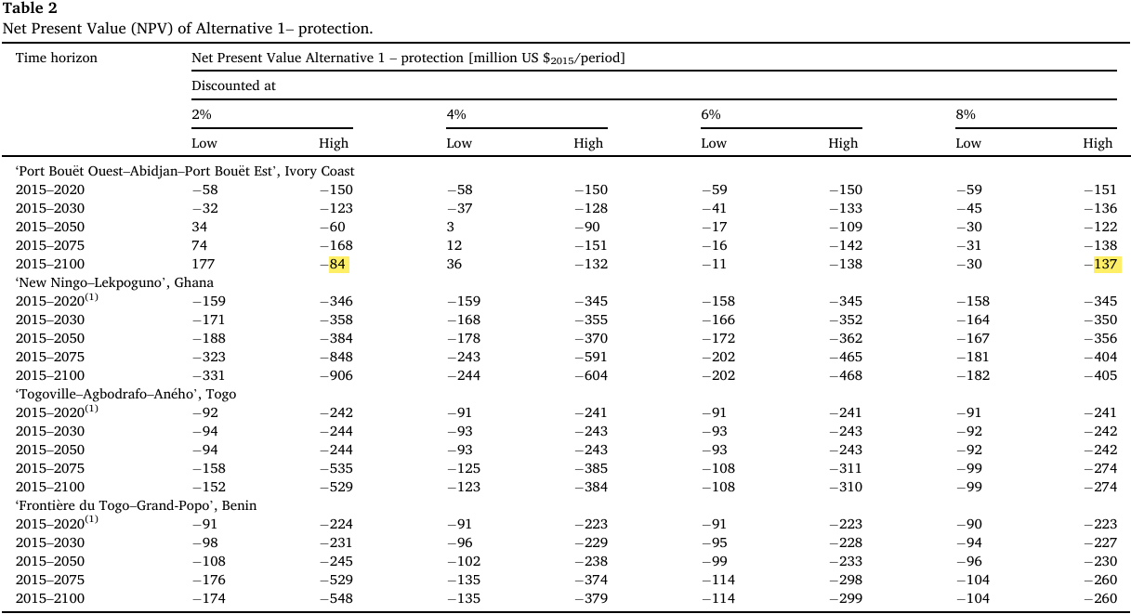
Sketch of Quantification Approach
Benefits: lives, land, and economic prosperity preserved
Costs: implementation
Lives: flooding costs 0.07 lives/year per 1,000 people exposed; valued by VSL, scaled by GDP/capita
Economic prosperity: national GDP/capita, scaled by number of people
Buildings etc. valued at their replacement costs
Costs from previous efforts at maintaining coastline and resettlement

Slide 75
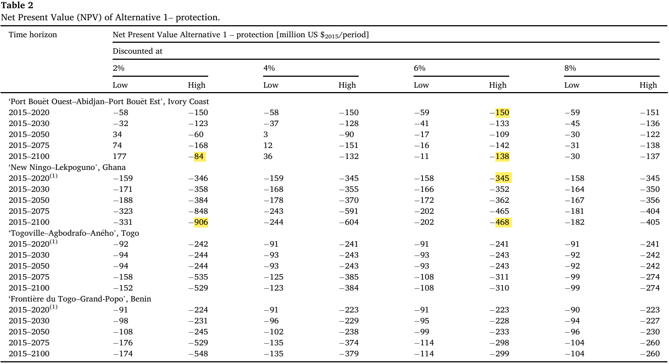
Sketch of Quantification Approach
Benefits: lives, land, and economic prosperity preserved
Costs: implementation
Lives: flooding costs 0.07 lives/year per 1,000 people exposed; valued by VSL, scaled by GDP/capita
Economic prosperity: national GDP/capita, scaled by number of people
Buildings etc. valued at their replacement costs
Costs from previous efforts at maintaining coastline and resettlement

Slide 76
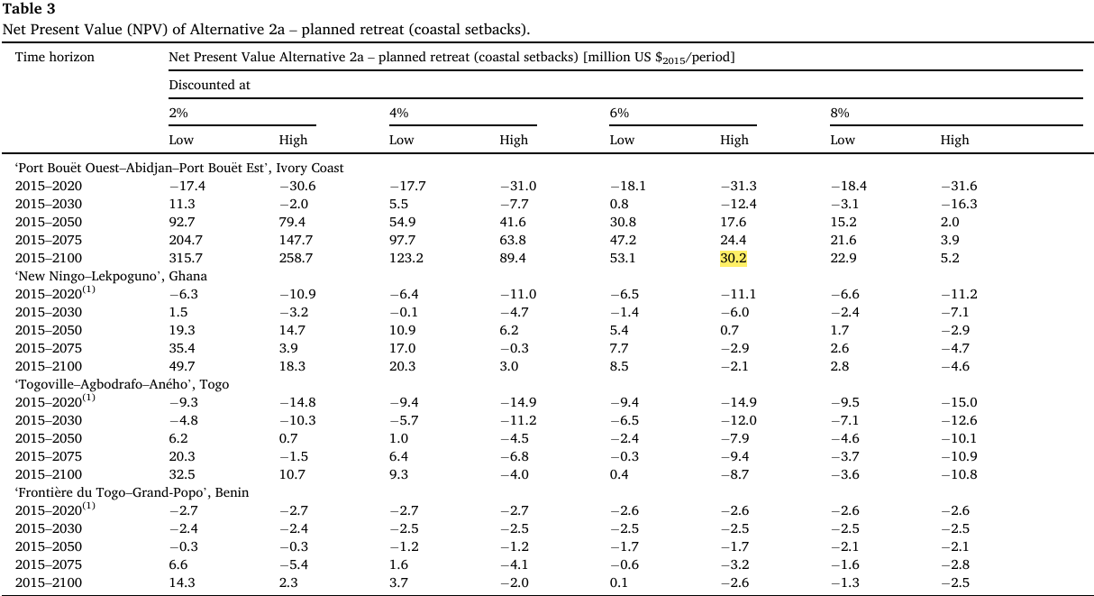
Sketch of Quantification Approach
Benefits: lives, land, and economic prosperity preserved
Costs: implementation
Lives: flooding costs 0.07 lives/year per 1,000 people exposed; valued by VSL, scaled by GDP/capita
Economic prosperity: national GDP/capita, scaled by number of people
Buildings etc. valued at their replacement costs
Costs from previous efforts at maintaining coastline and resettlement

Slide 77
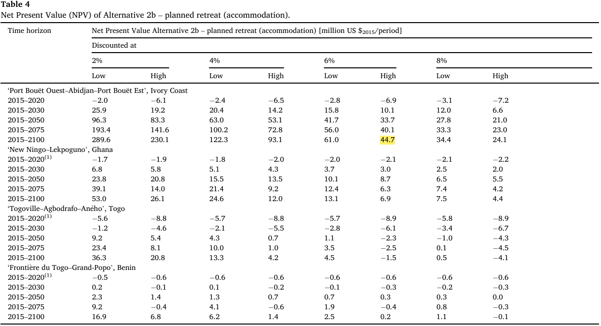
Sketch of Quantification Approach
Benefits: lives, land, and economic prosperity preserved
Costs: implementation
Lives: flooding costs 0.07 lives/year per 1,000 people exposed; valued by VSL, scaled by GDP/capita
Economic prosperity: national GDP/capita, scaled by number of people
Buildings etc. valued at their replacement costs
Costs from previous efforts at maintaining coastline and resettlement

Slide 78
Blind Spots
Distributional impact (likely to help poorer more)
Prevents shift away from agriculture (so hurts economic growth, but…)
No consideration for environment or cultural sites (understates projects’ values)
Assumes worst-case climate scenario!
Perhaps okay for comparing policies against each other, but not okay for comparing to status quo – overstates benefits of policies
No attempt to take uncertainty seriously

Slide 79
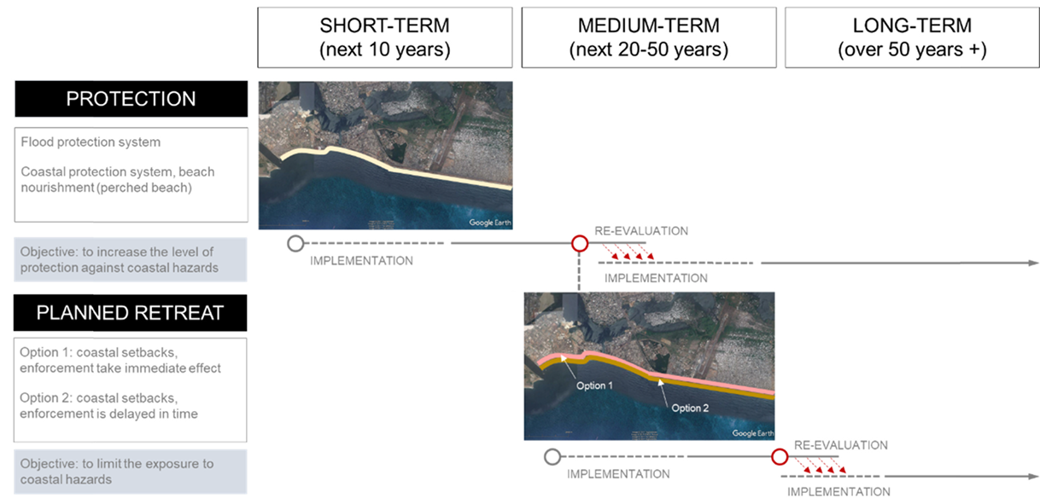
Option Value

